Slide 1
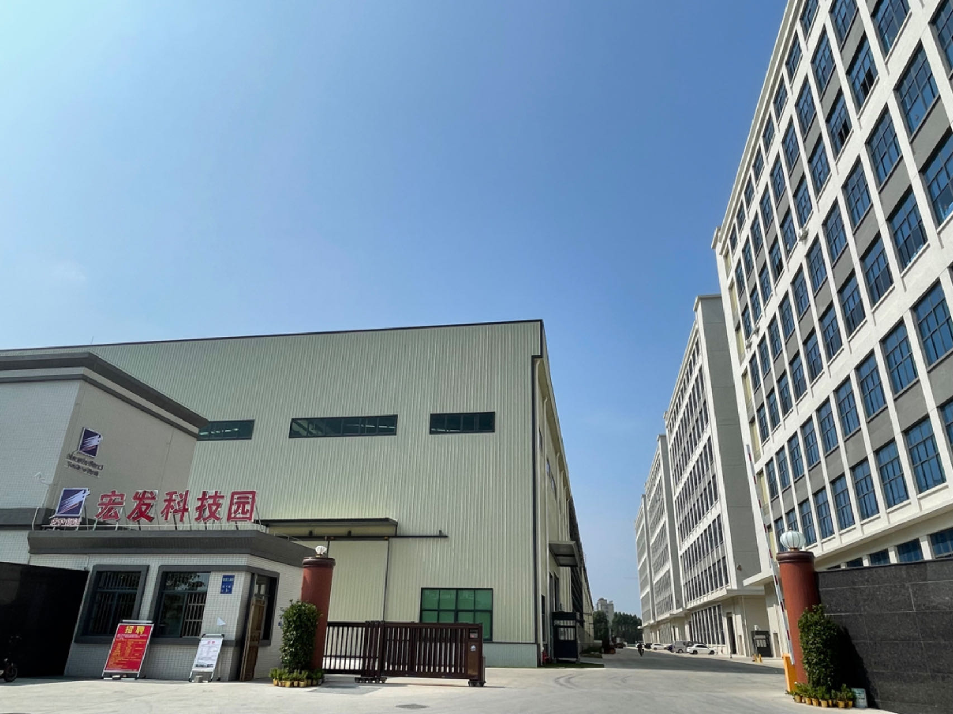

Dongguan Pengji Electronics Co.,Ltd
PENGJI PRODUCT CATALOG
https://pj-cable.com

Slide 2
Company Introduction
Dongguan Pengji Electronics Co.,Ltd
Dongguan Pengji Electronic Technology Co., Ltd. has been making wire for over 16 years. We provide a one-stop solution for wire manufacturing. We do OEM cables for all kinds of customers. Our main products are USB, audio video, HDMI, USB-C, and Ethernet cables. We have two factories in China. They have all the production equipment you could need, including stranding machines, core extruders, stripping machines, automatic welders, injection molding machines, and more. Our products have many certificates, including CE, RoHS, CCC, HDMI, and more. We welcome customers from around the world to contact us and visit us!

Slide 3
Company Milestones
Dongguan Pengji Electronics Co.,Ltd
In 2011, based on existing customer resources,the industry was gradually optimized and adjusted.
Plan for the next 3 years:
1. Increase 2-3 production bases in Vietnam
2. Increase the production volume of USB cable.
3. Establishment of usb cable brand.
4. The number of people in the overall industry chain increased to 500-1,000.
In 2007, Dongguan Pengji Factory was established, mainly engaged in terminal wiring harnesses. Total 50 employees, 3 million turnover a year, with steady growth of 25% per year.
2009 Transformed into processing/production of CORD ASS'Y and ASS'Y finished products.
In 2013, Taiwan Tokyo Light & Electric Co., Ltd. CORD ASS'Y parts were recognized.
2007
2008
2009
2010
2011
2012
2013
2015
2020
2024
In 2015, the CORD ASS'Y parts of Japan's JVC Shenzhen Division were recognized.
In 2015, Chaosheng Electronics CORD ASS'Y parts and head-mounted ASS'Y finished products were recognized.
In 2012, Pengji factory was relocated due to plant expansion; we integrated various internal resources to meet customer needs, added relevant mass production equipment, we were able to provide service products such as wire extrusion, semi-finished product processing, and finished product processing, with nearly 200 employees, 15million turnover per year.
In 2010, Japan JVC Shenzhen Division's ASS'Y completed product was recognized.
2010 Japan SAMBON Electronics ASS'Y completed product approved
2008 Internal industrial mechanism adjustment

Slide 4
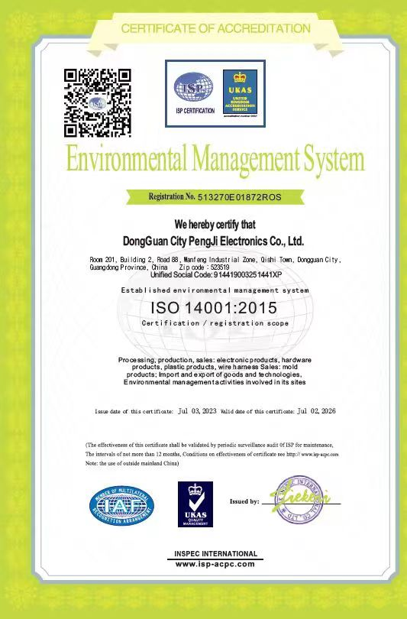
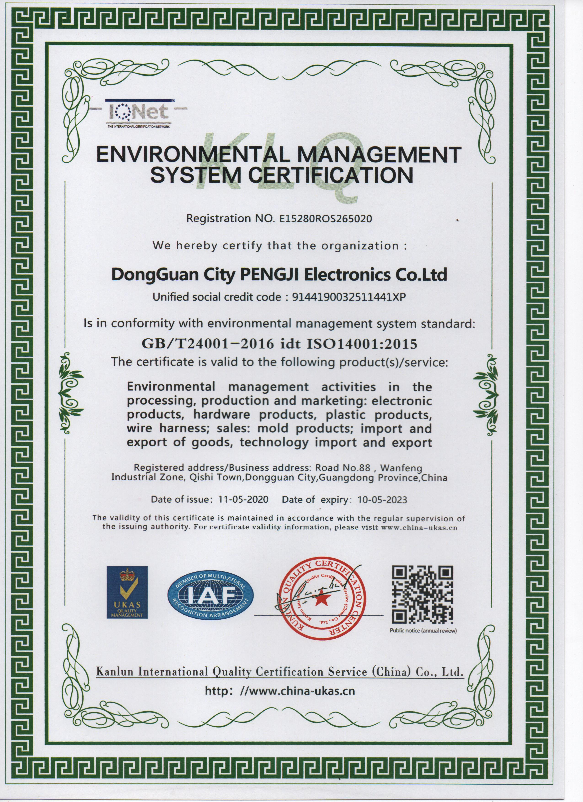
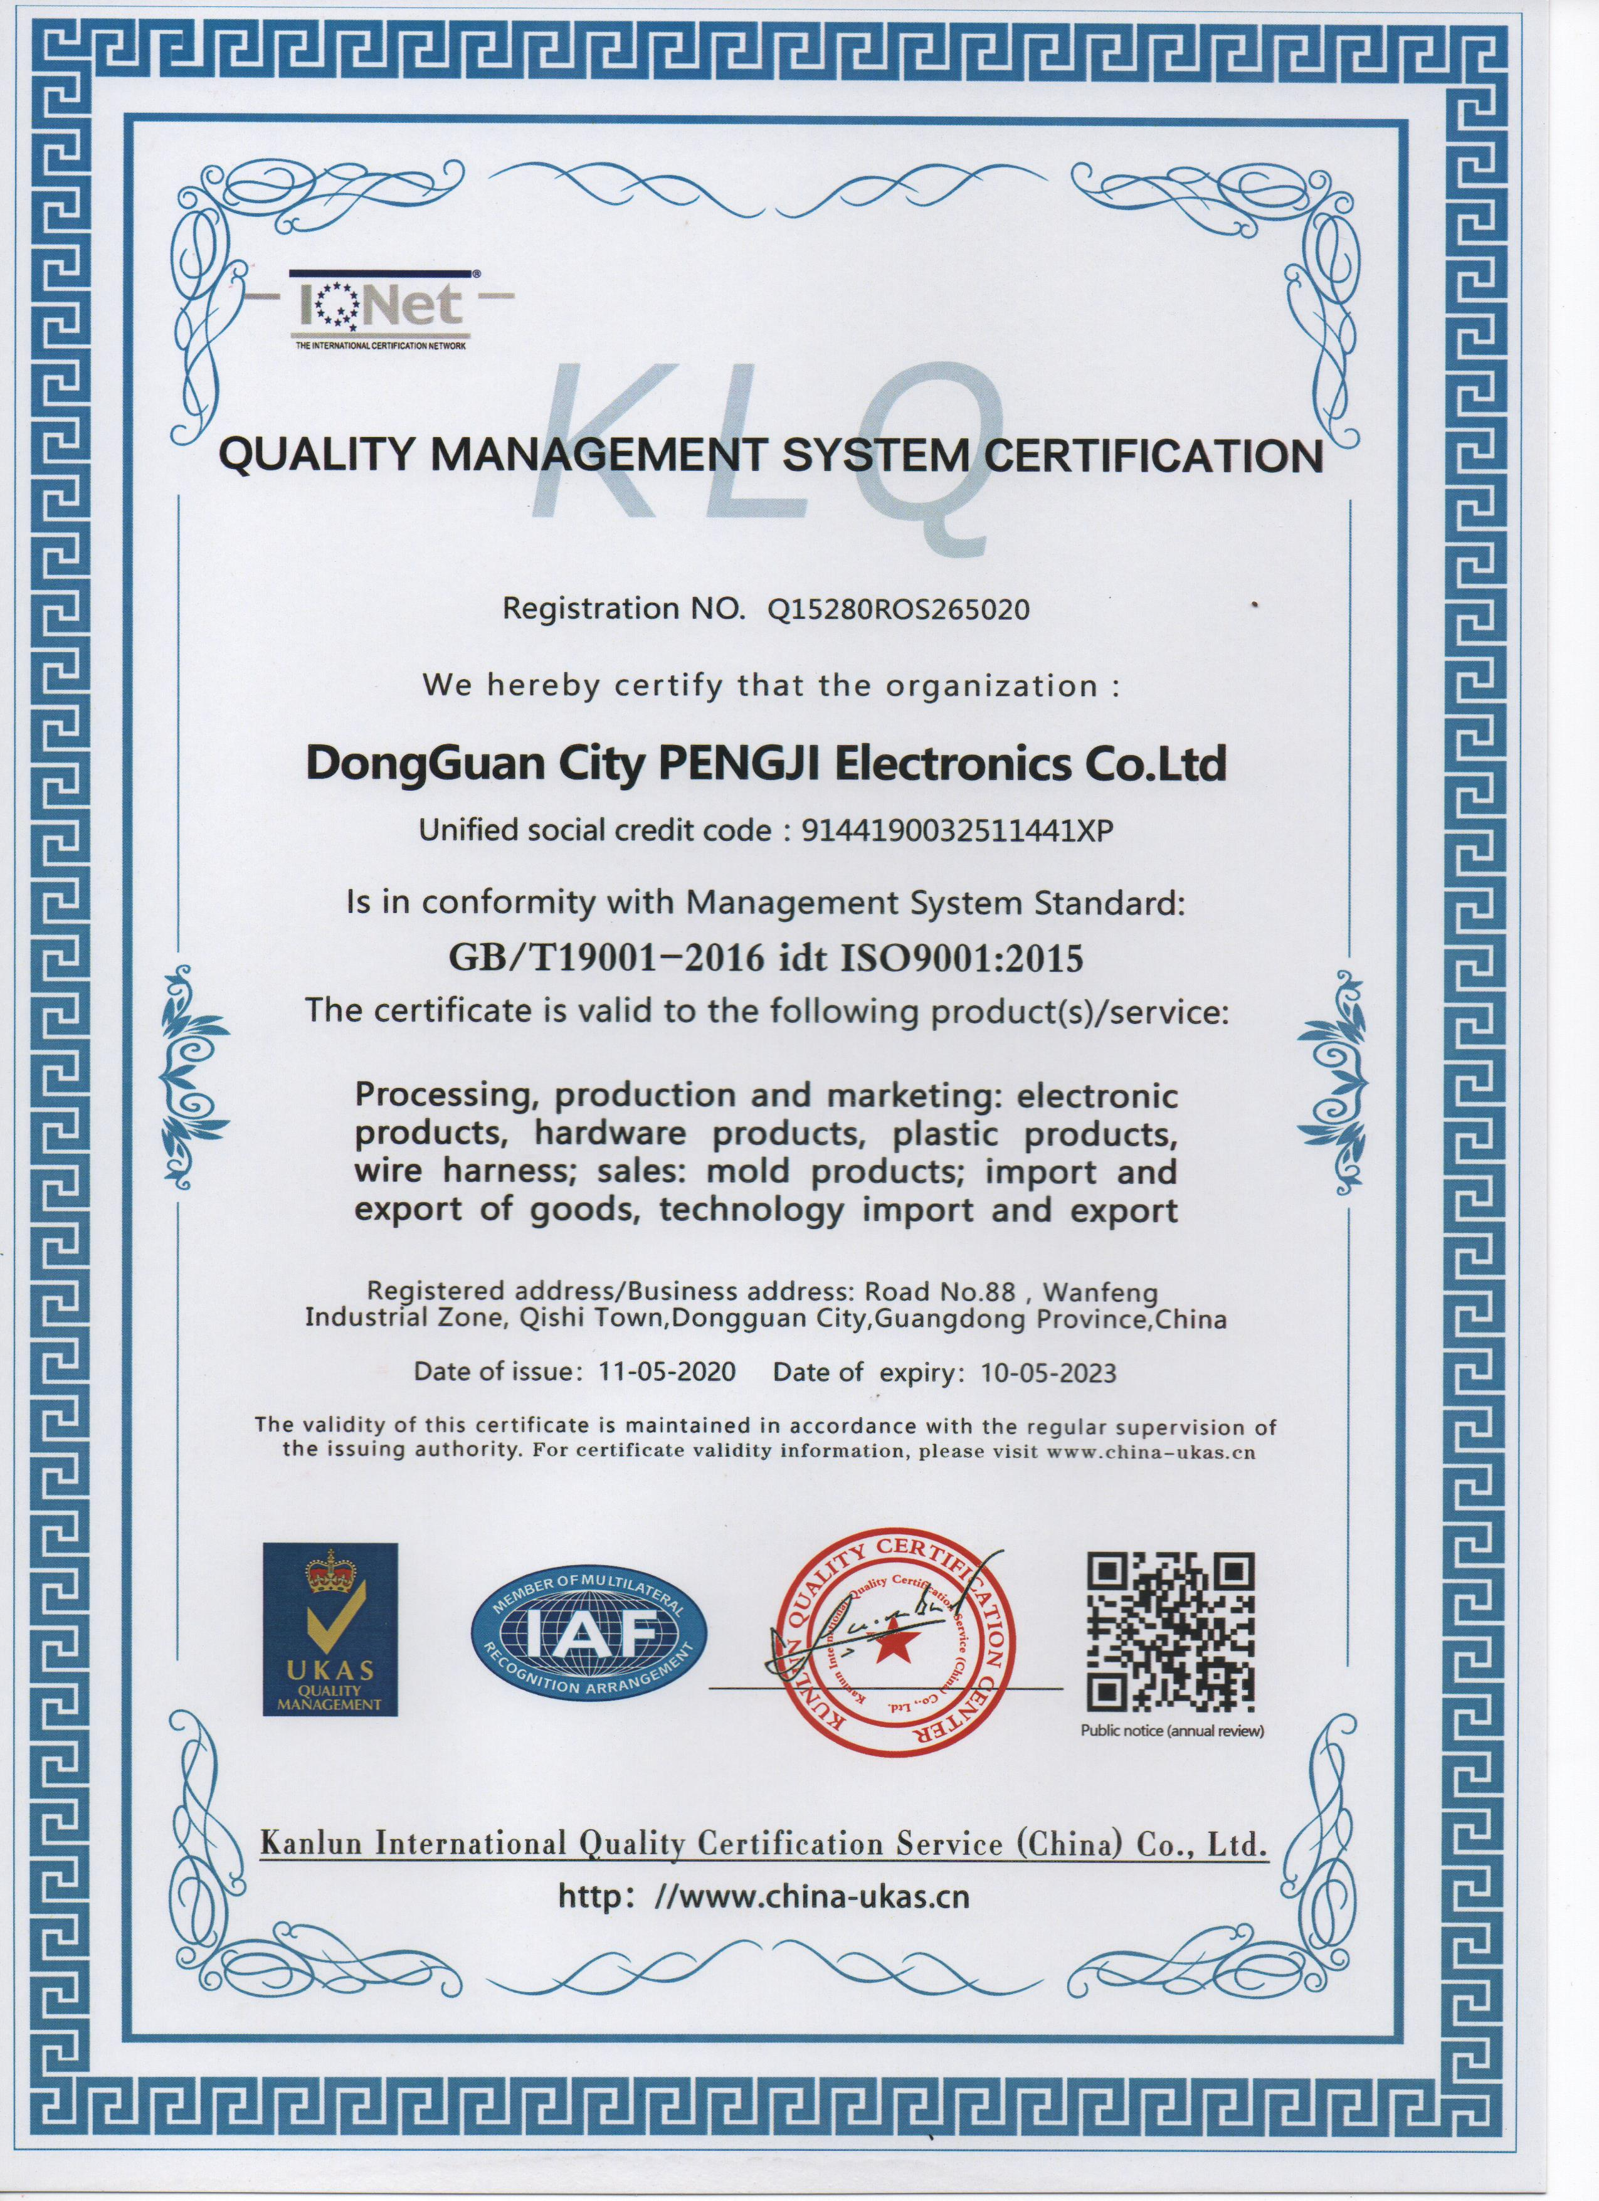
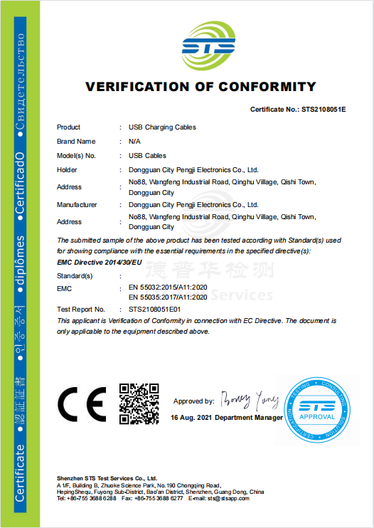
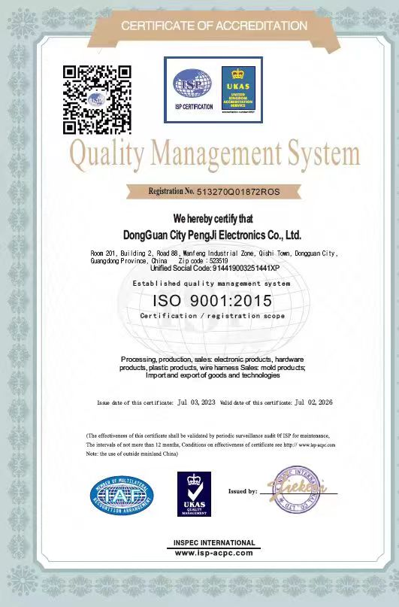
Our Certifications
Dongguan Pengji Electronics Co.,Ltd

Slide 5
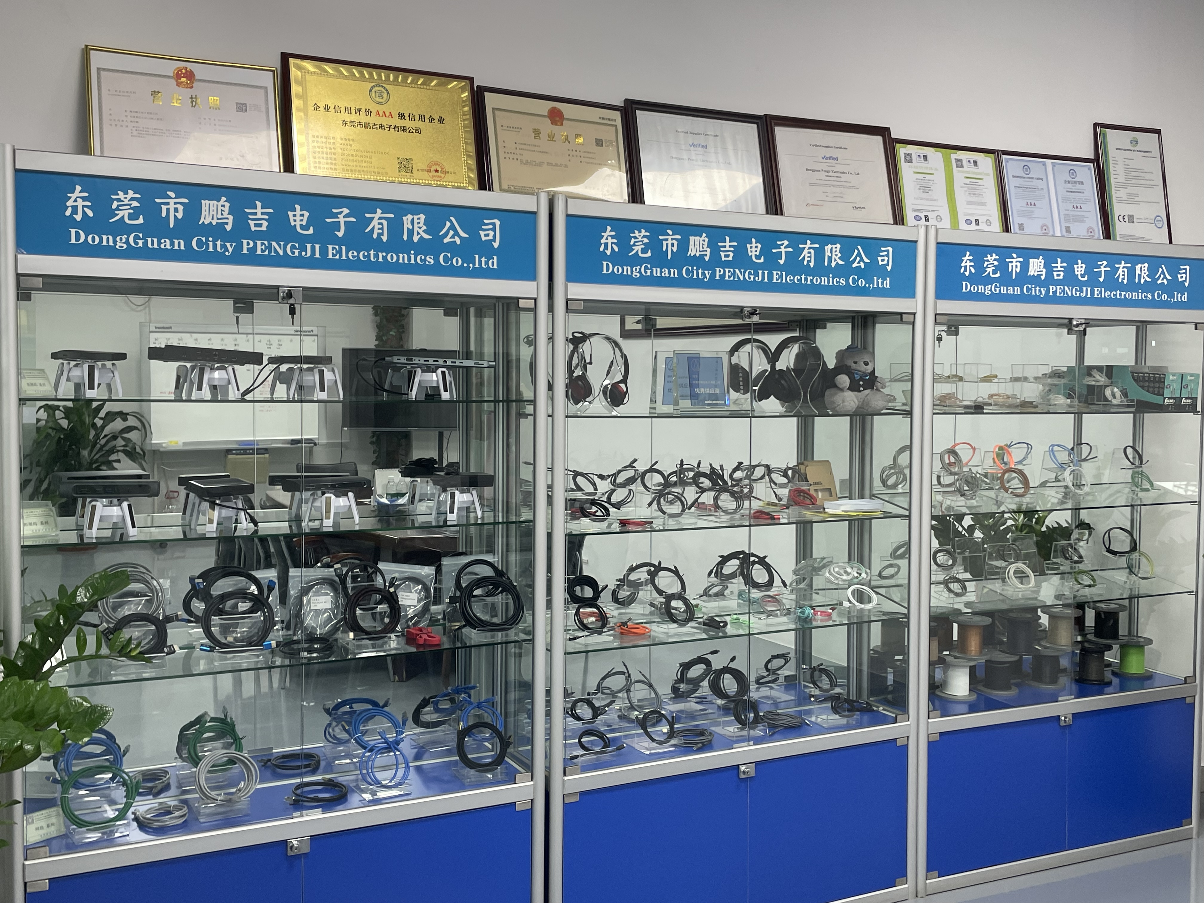
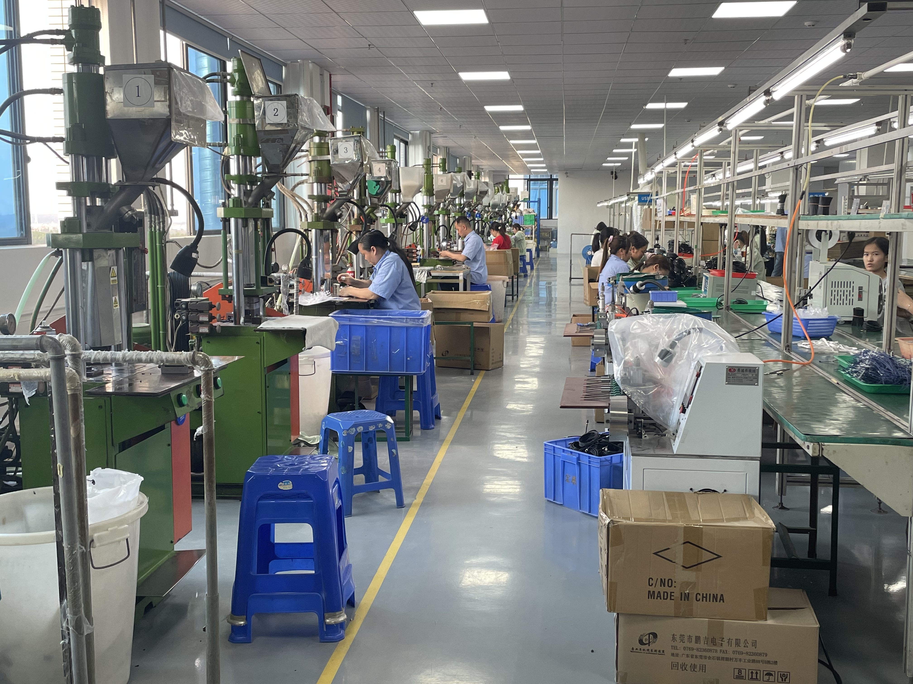
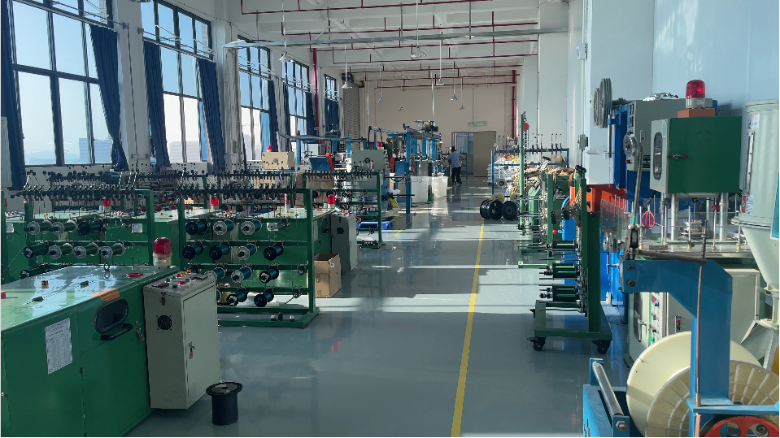
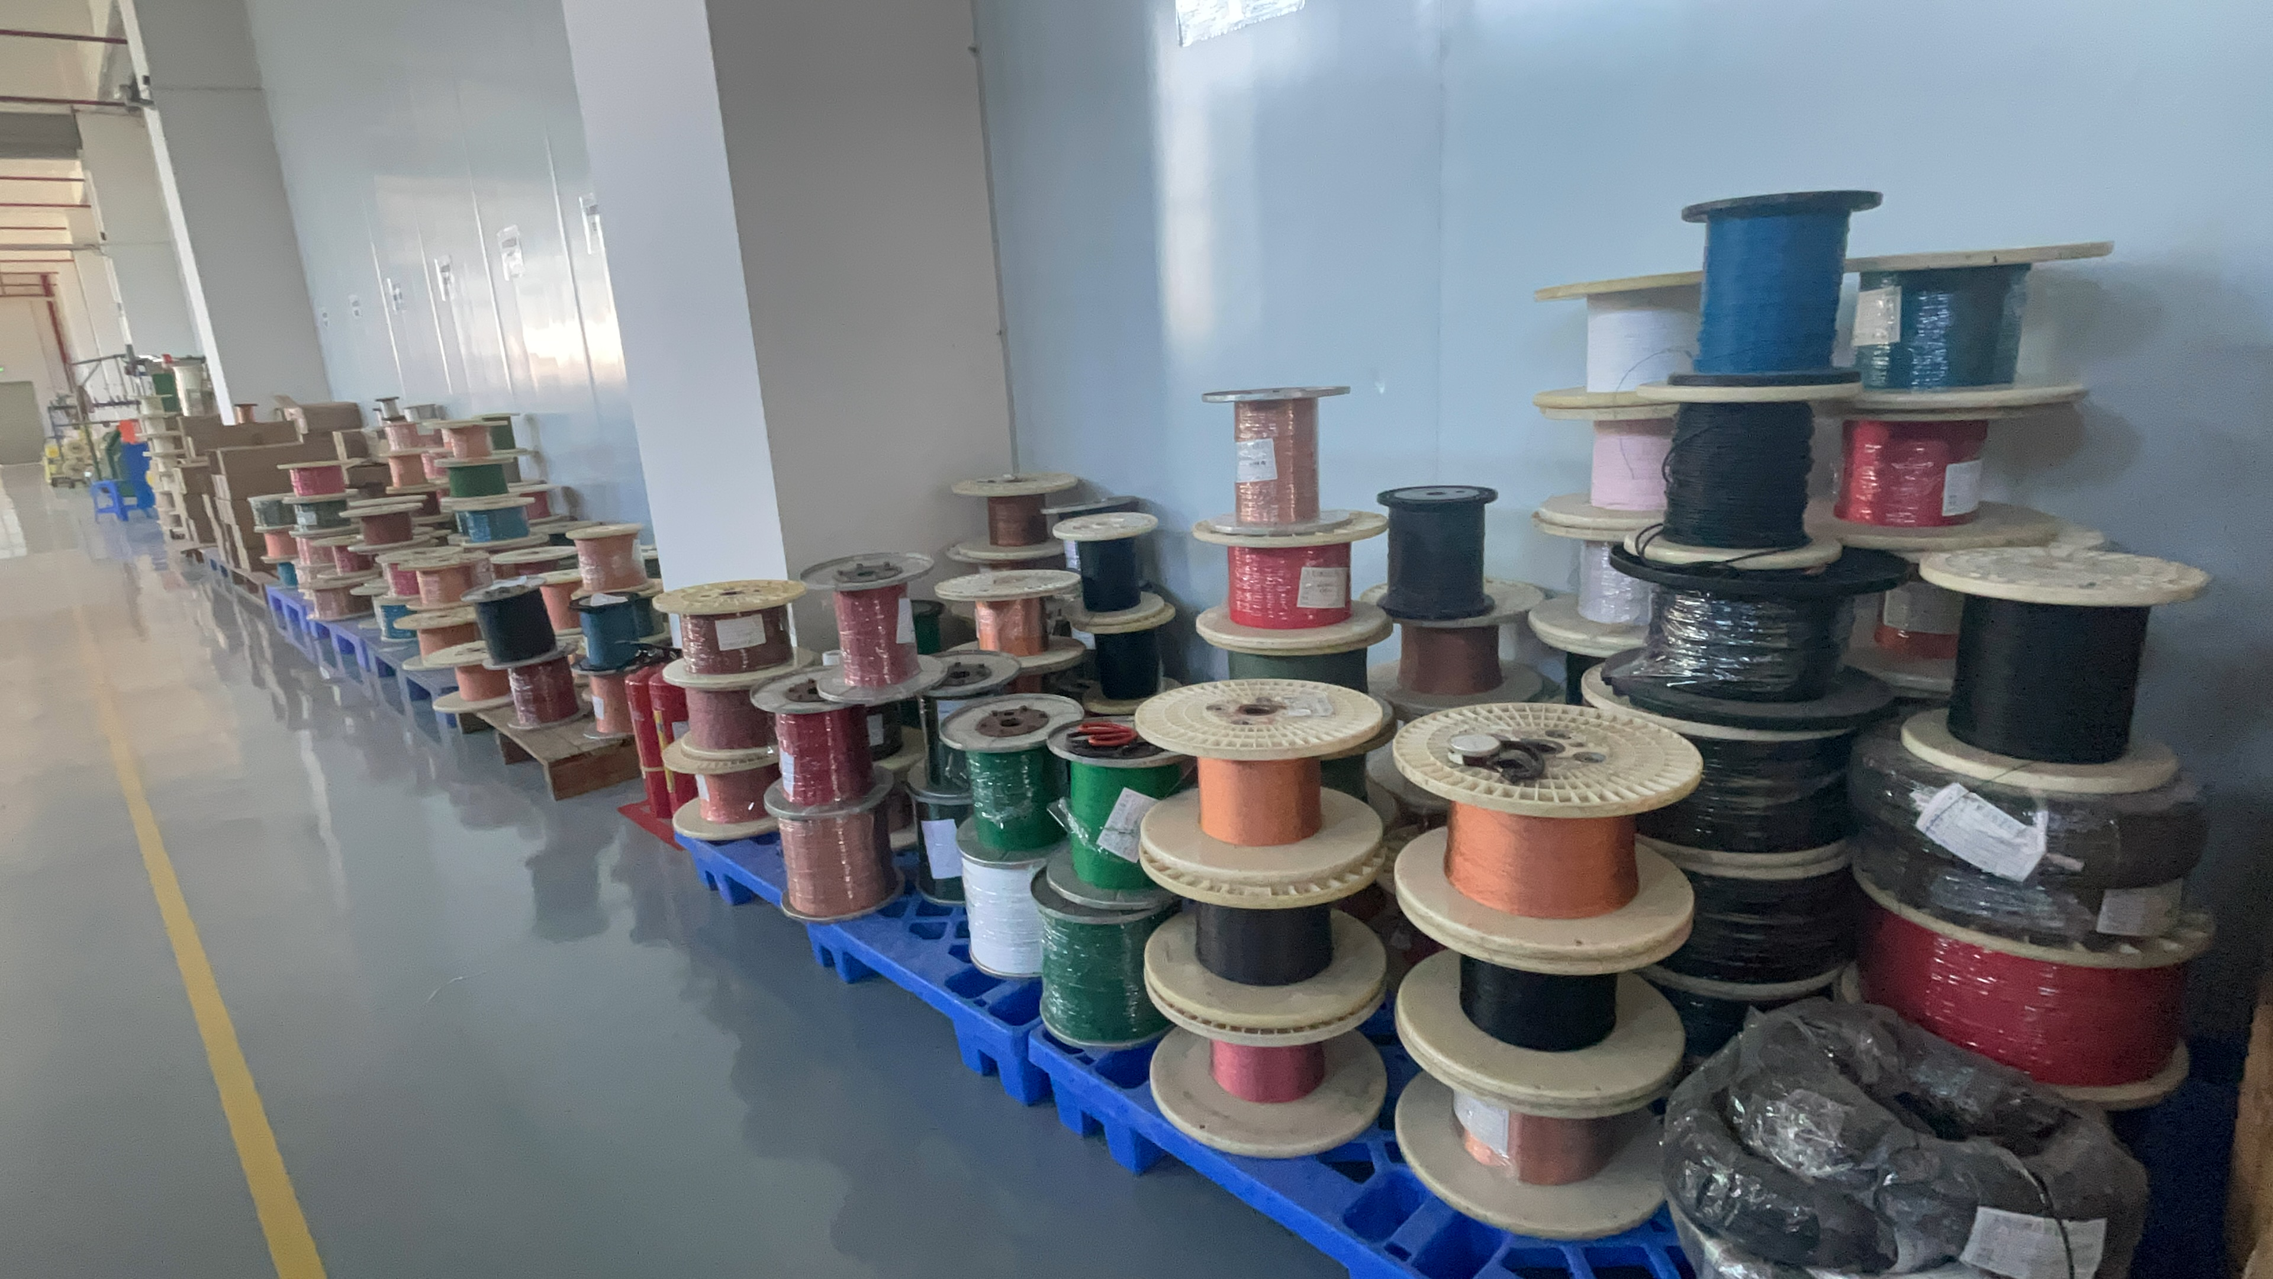
Production Line
Dongguan Pengji Electronics Co.,Ltd

Slide 6
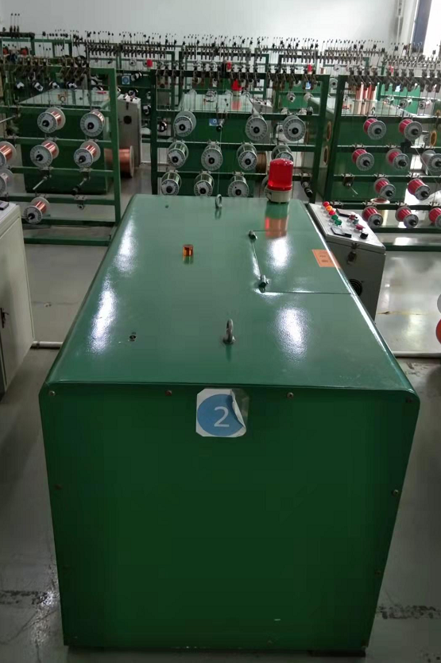
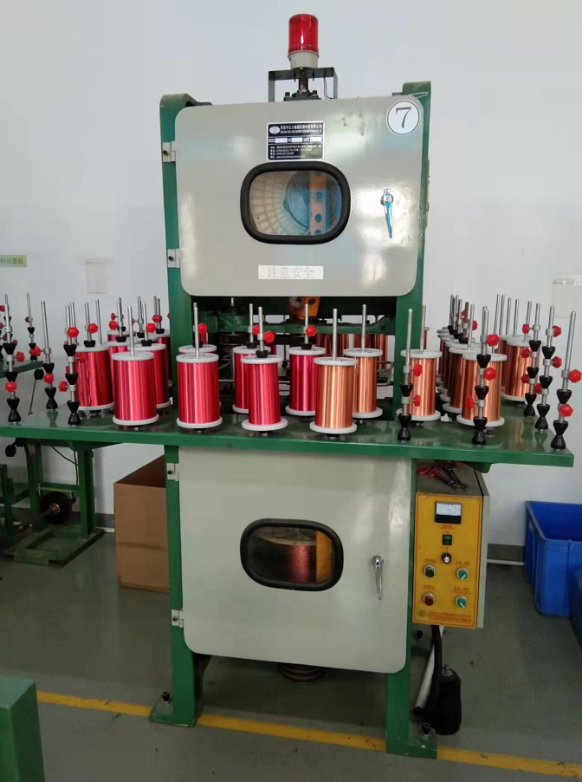
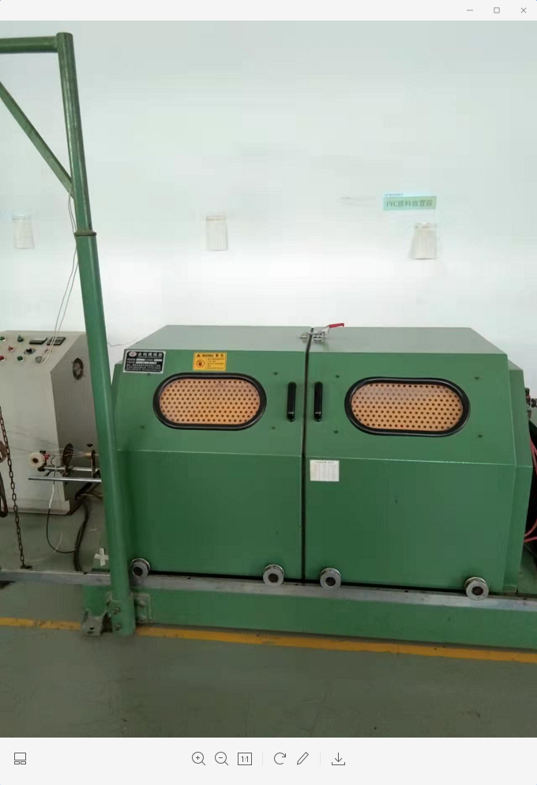
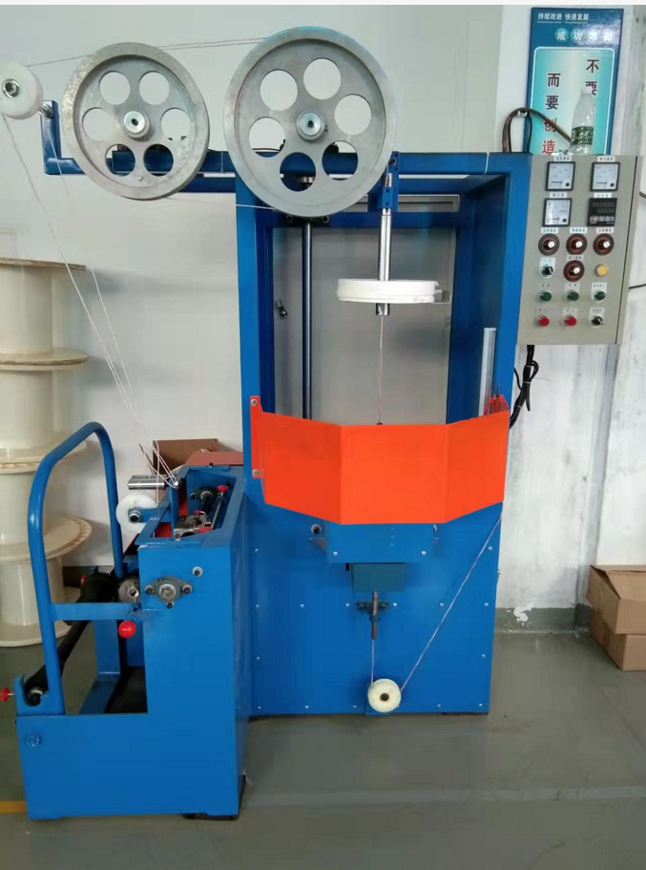
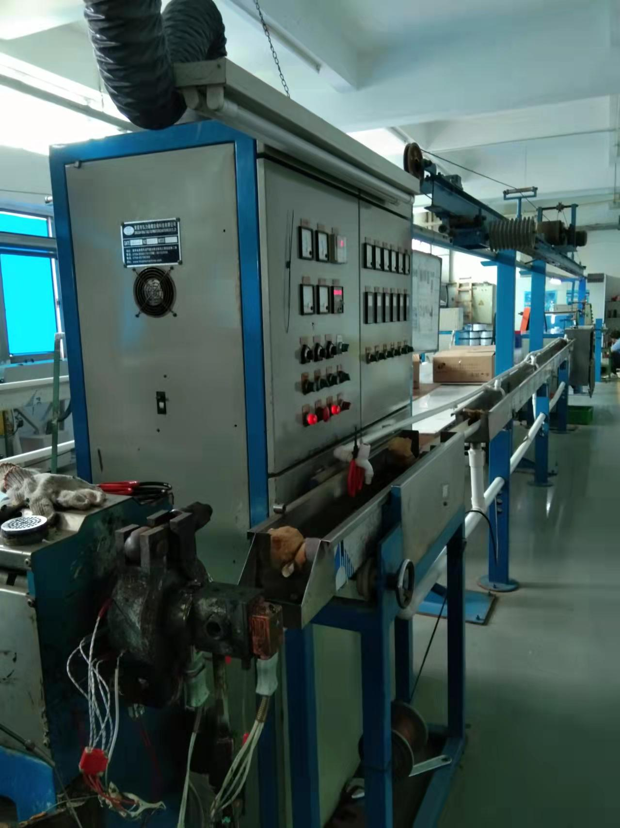
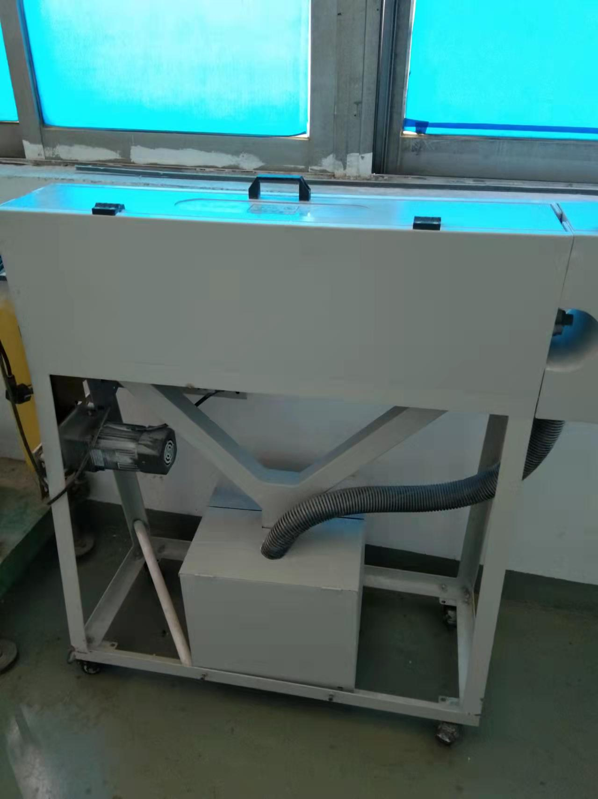
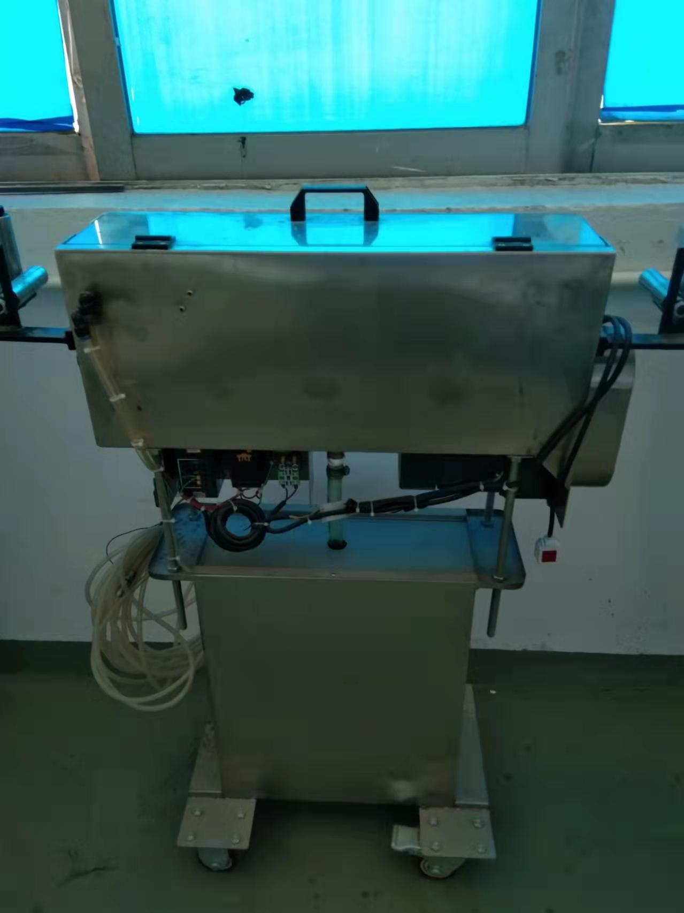
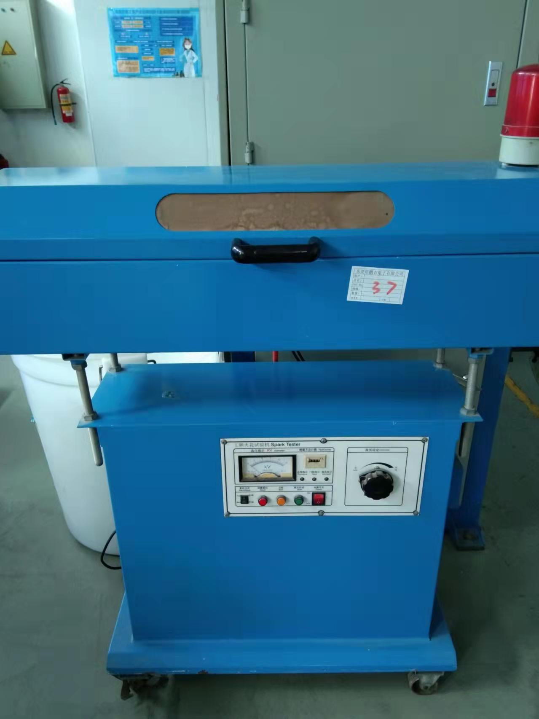
Devices
Dongguan Pengji Electronics Co.,Ltd
Stranding Machine
Winding Machine
Main Winch
Wrapping Machine
Extruder
Powder Passing Machine
Oil Filter
EDM Machine

Slide 7
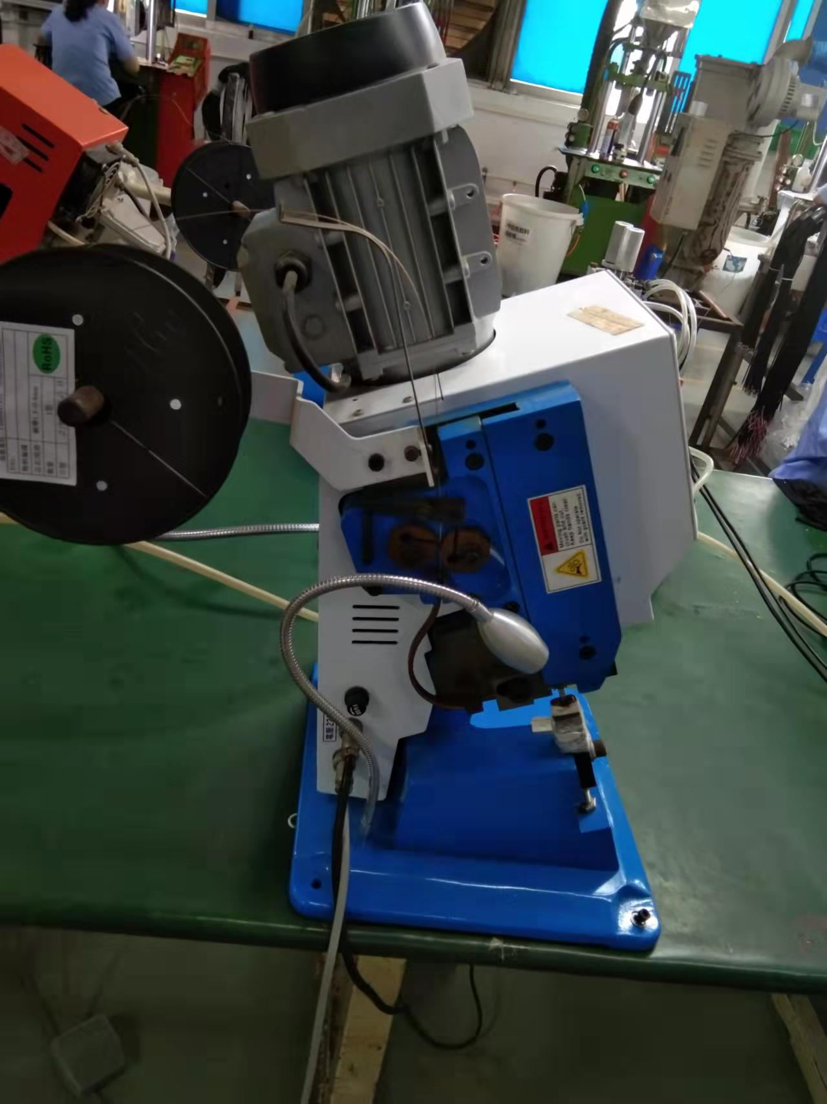
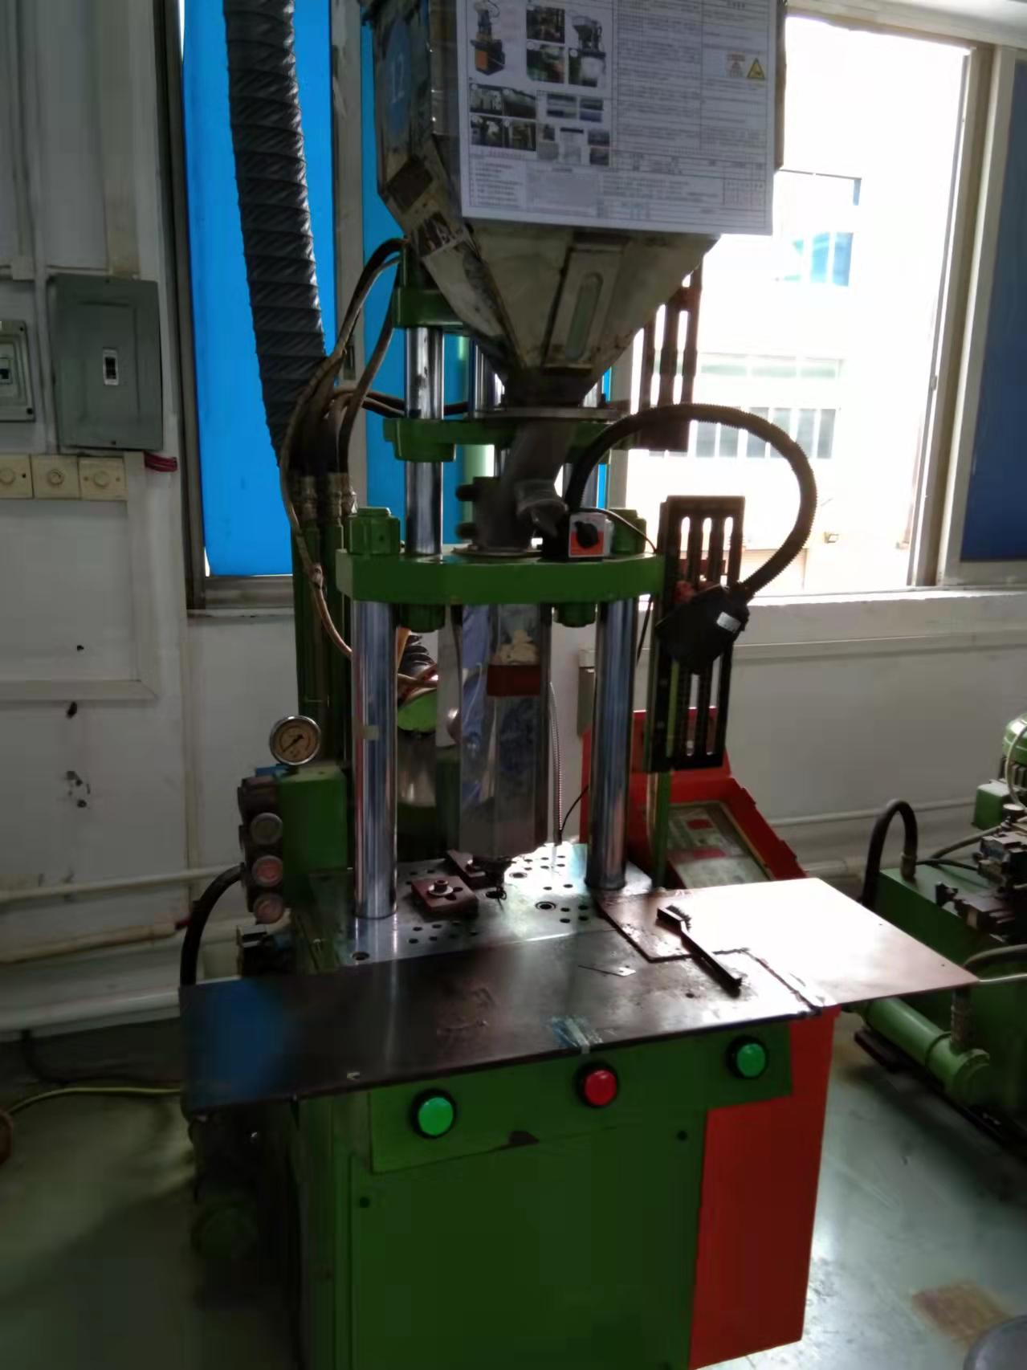
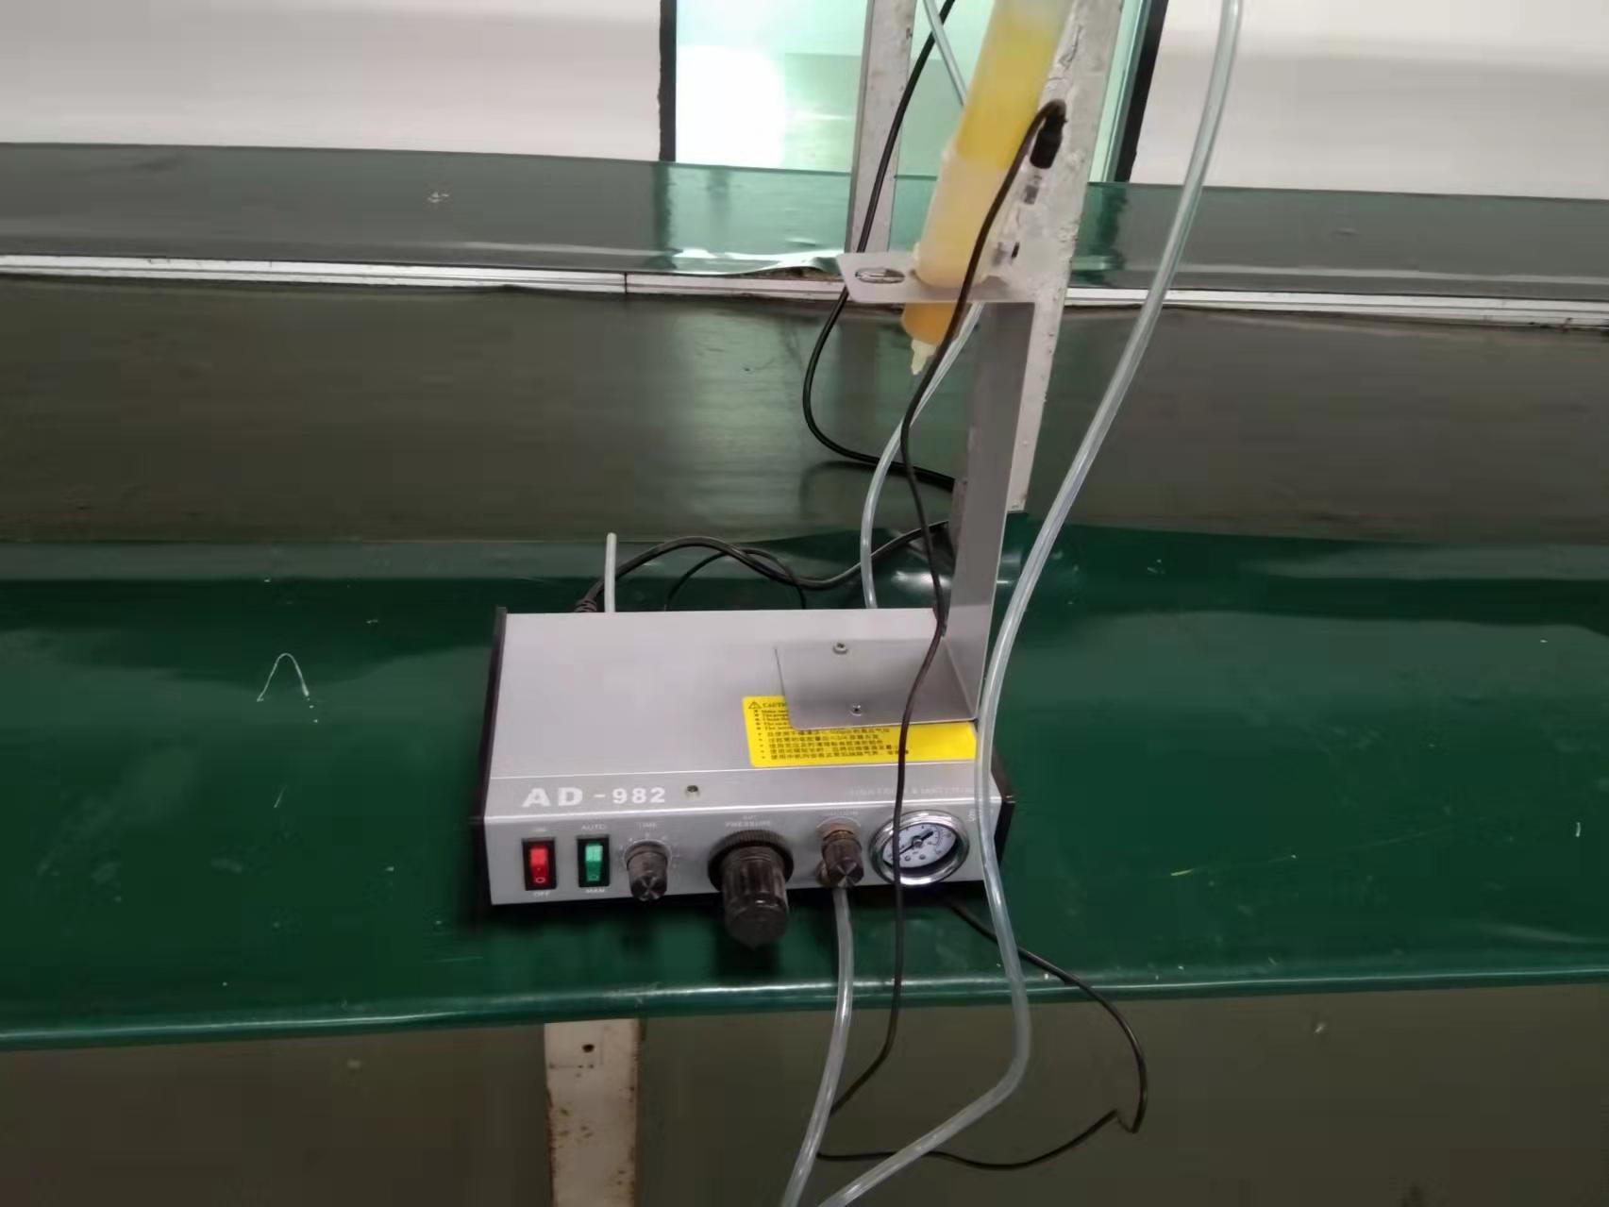
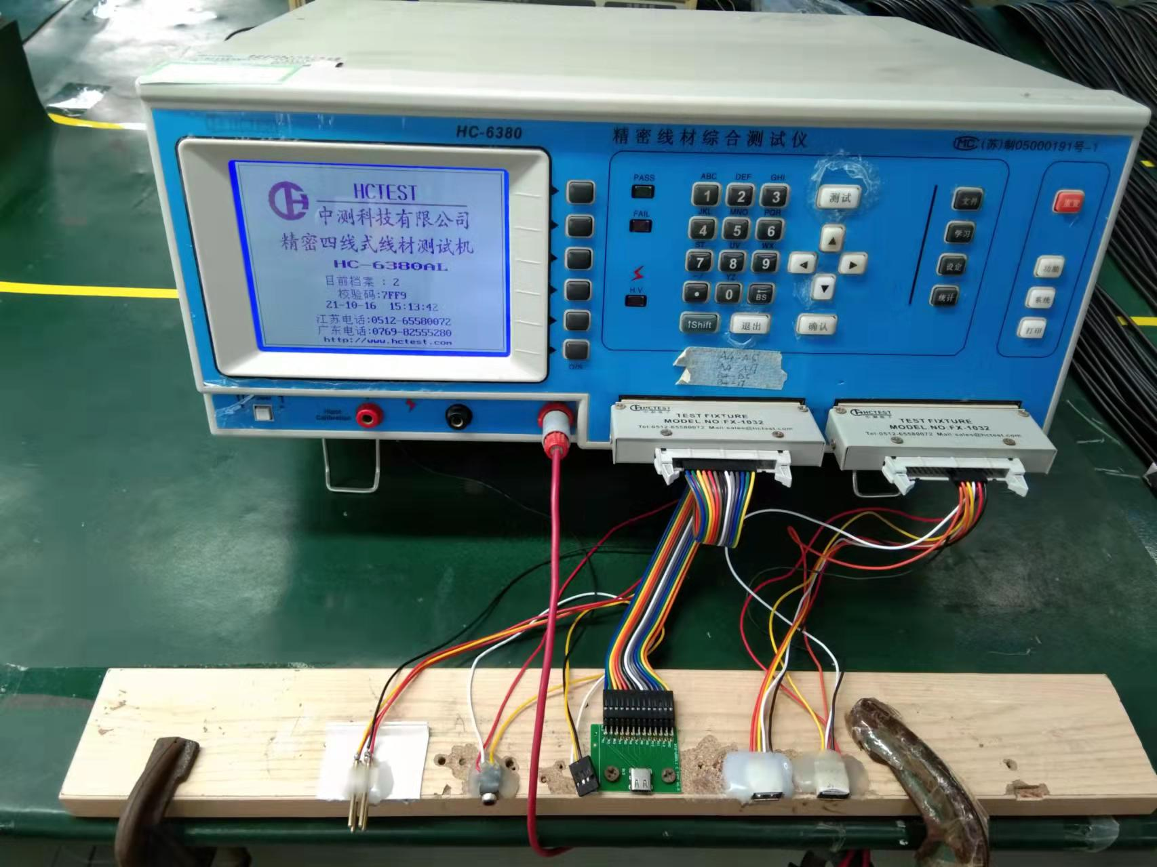
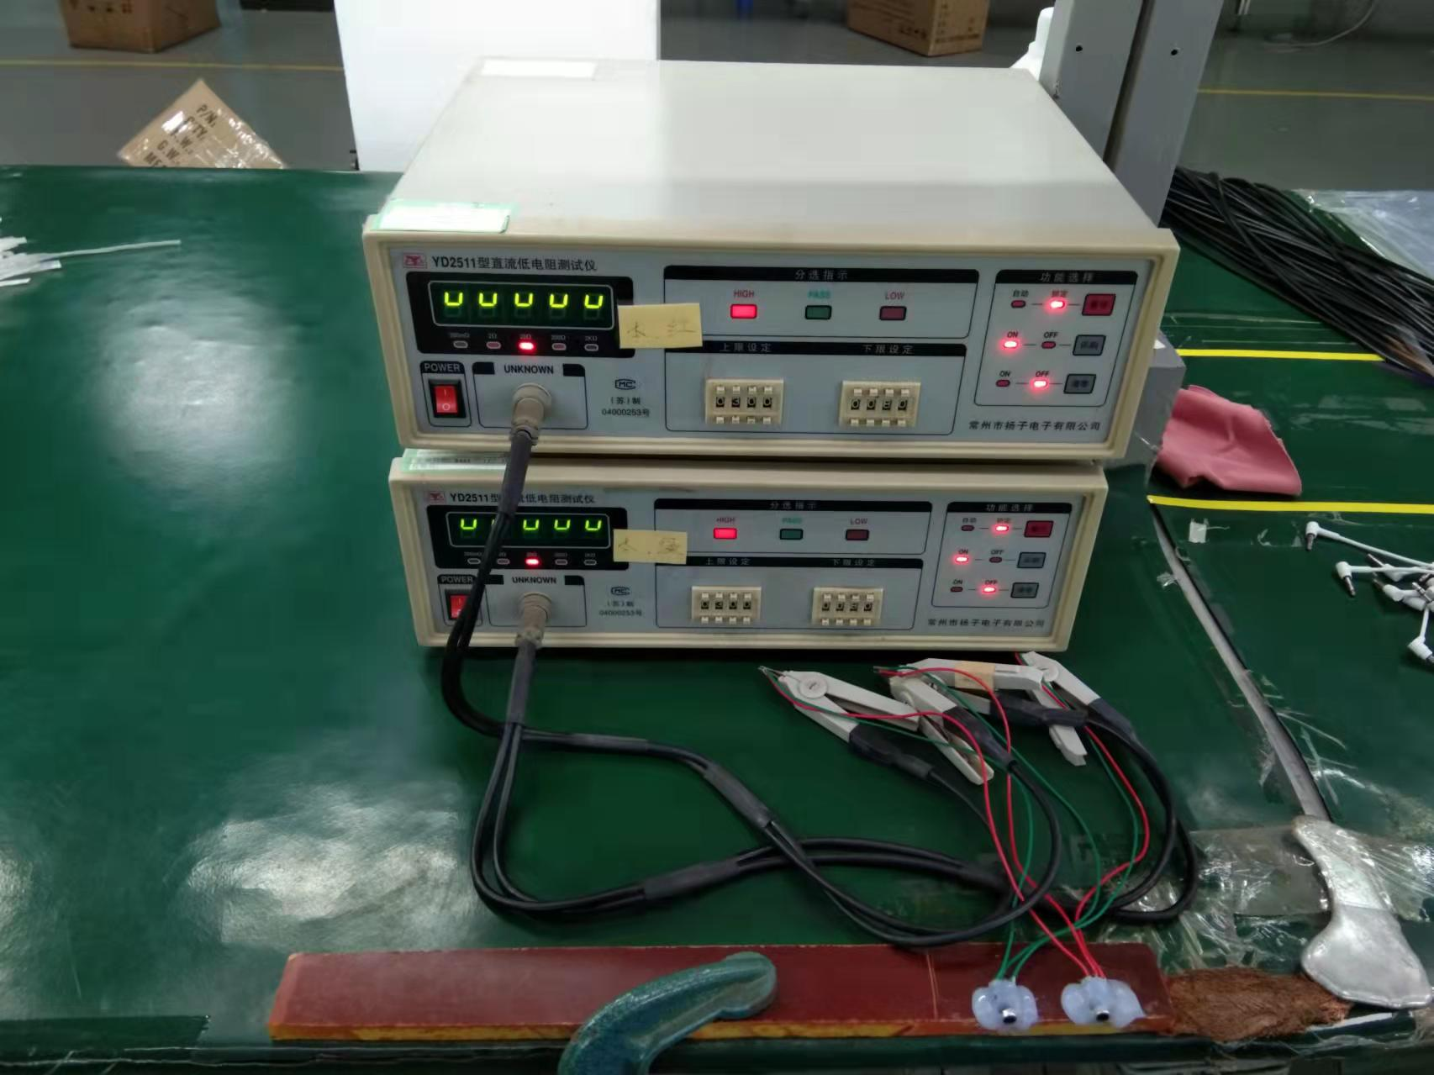
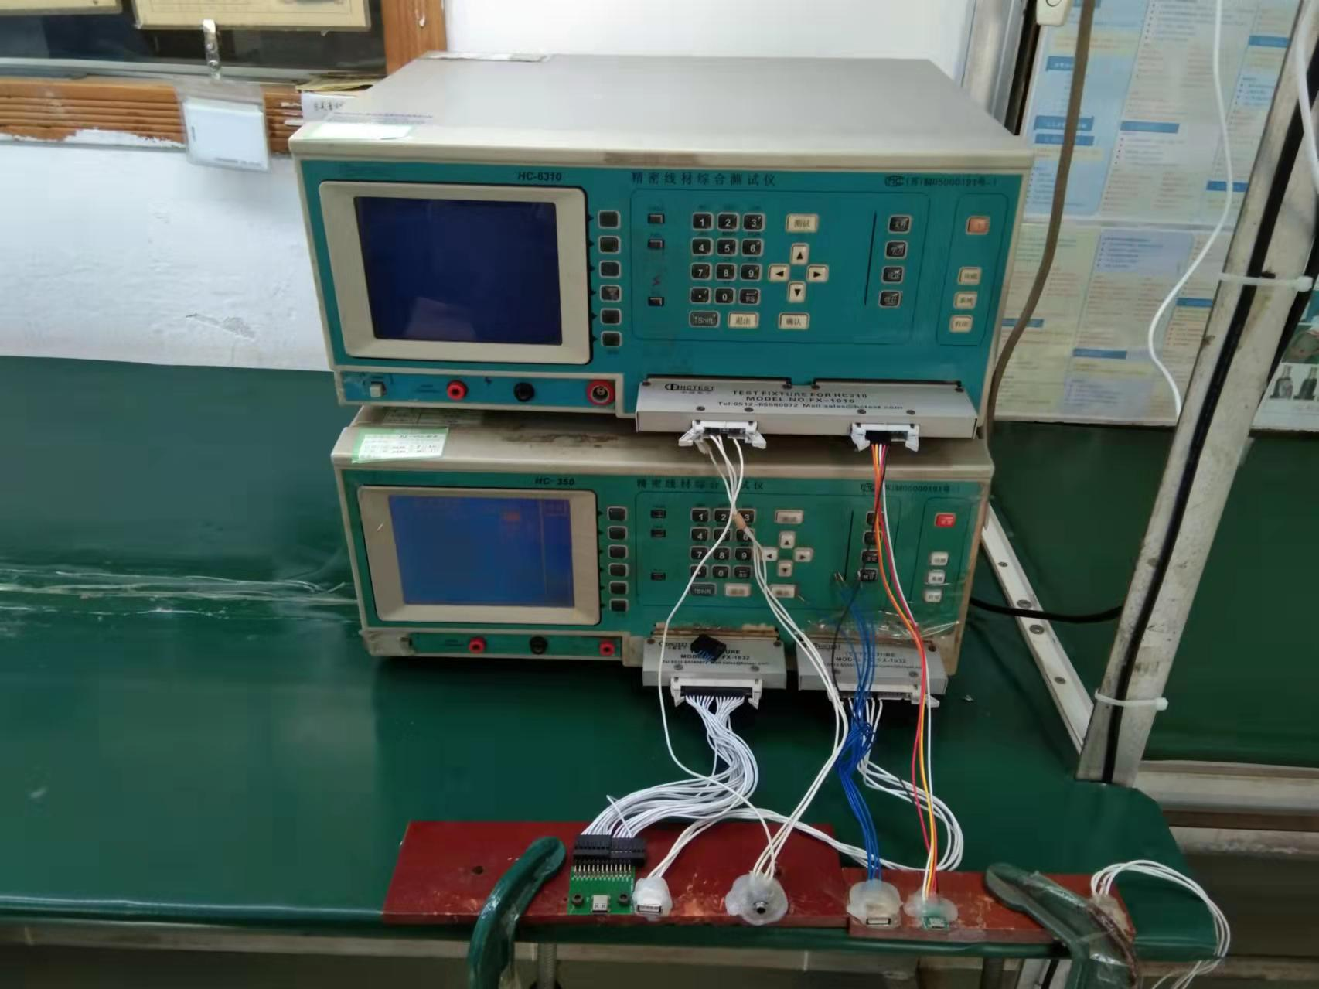
Devices
Dongguan Pengji Electronics Co.,Ltd
Copper Belt Press
Forming Machine
Dispensing Machine
Precision Wire Tester
Resistance Tester
Precision Wire Tester

Slide 8

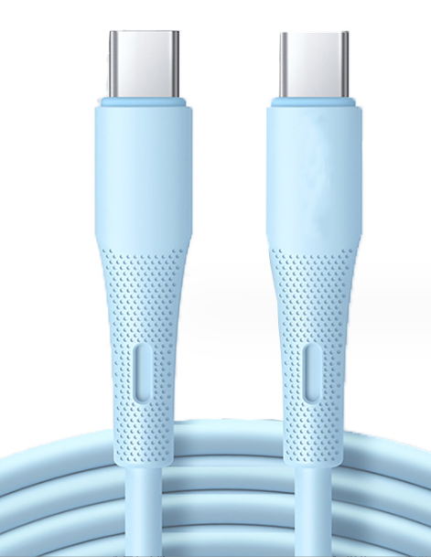
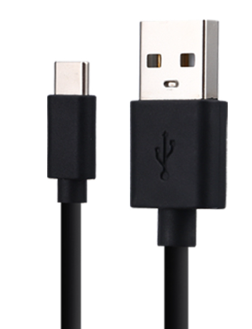
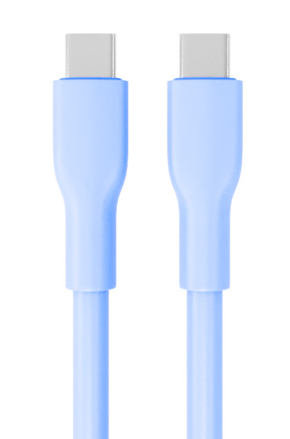
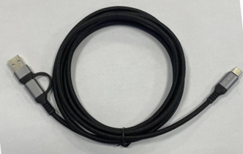
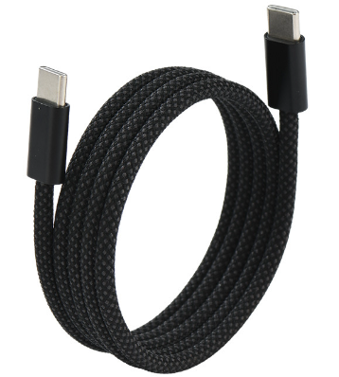
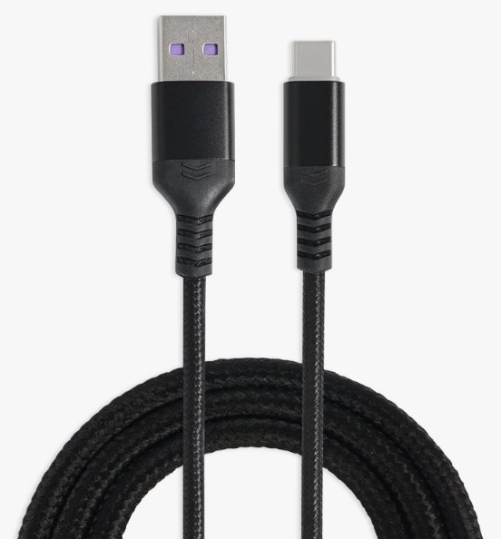
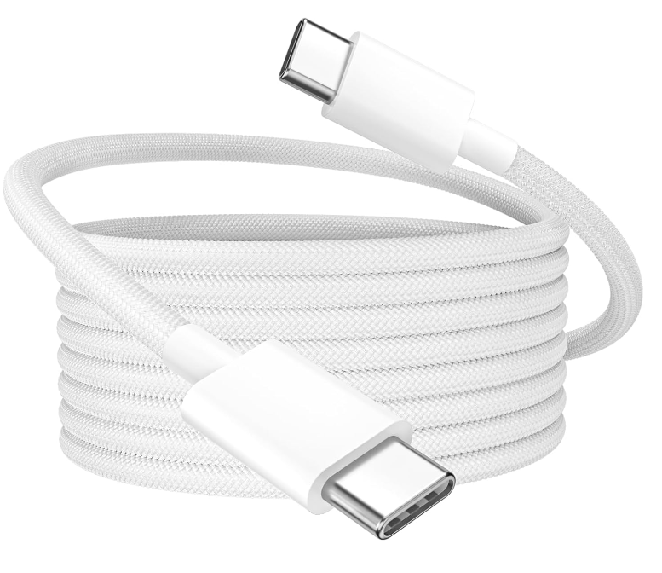
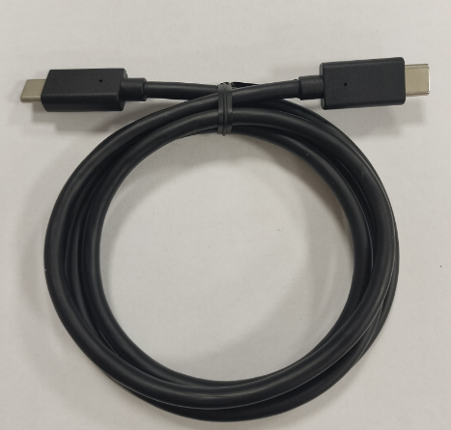
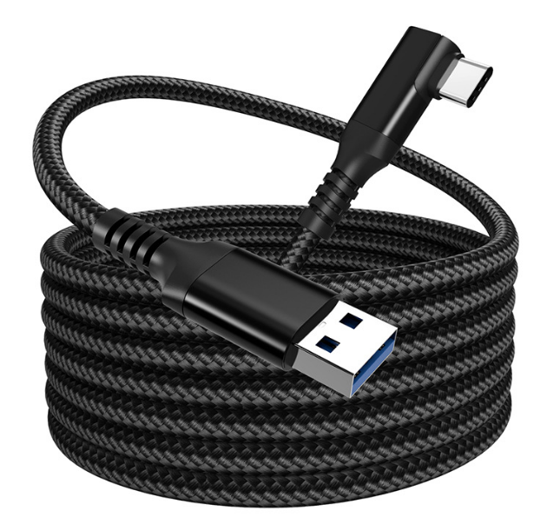
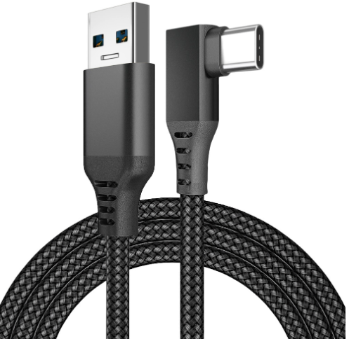

USB Cable
Model:PJ01
Model:PJ02
Model:PJ03
Model:PJ04
Model:PJ05
Model:PJ06
Model:PJ07
Model:PJ08
Model:PJ09
Model:PJ10
https://pj-cable.com

Slide 9
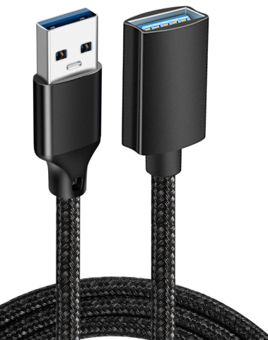
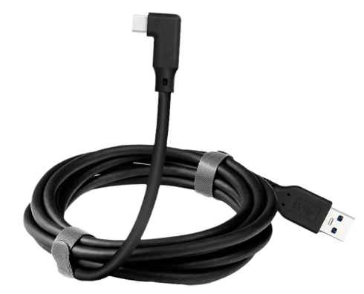
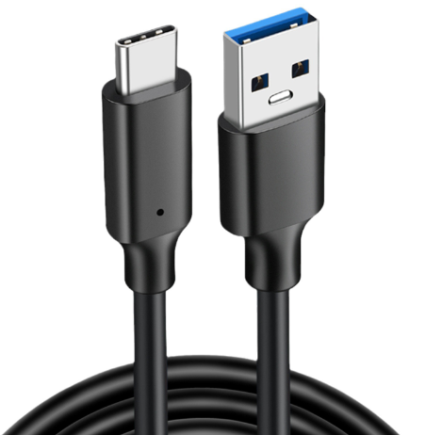
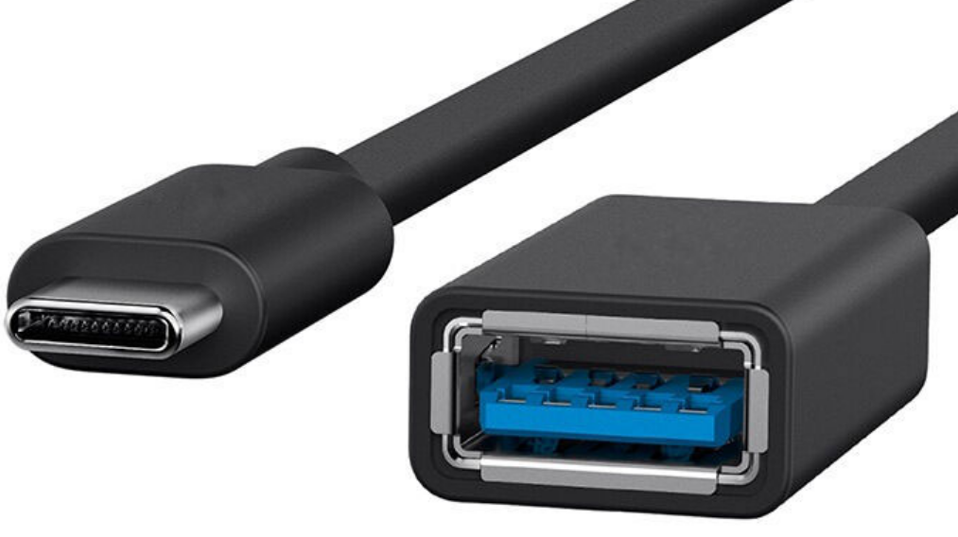
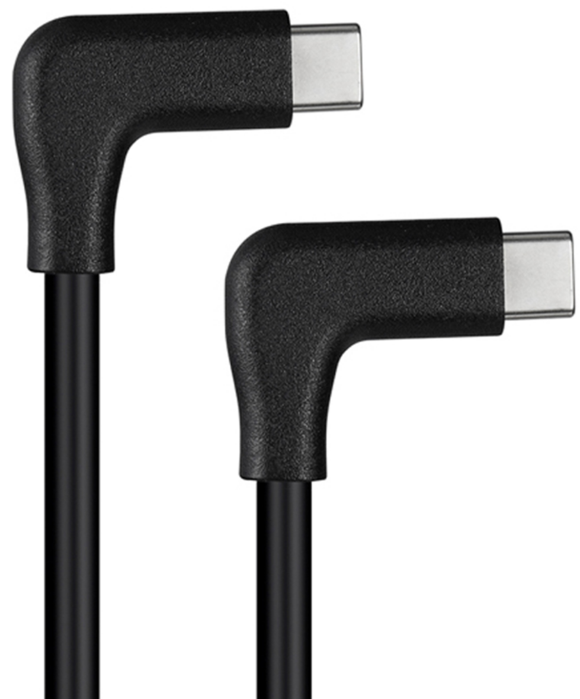
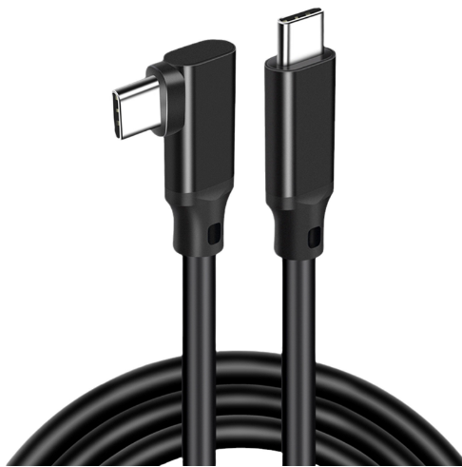
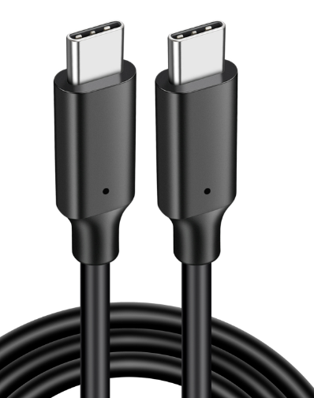
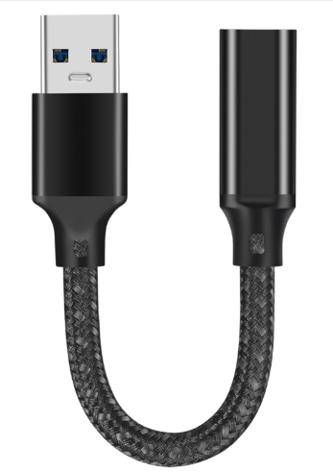
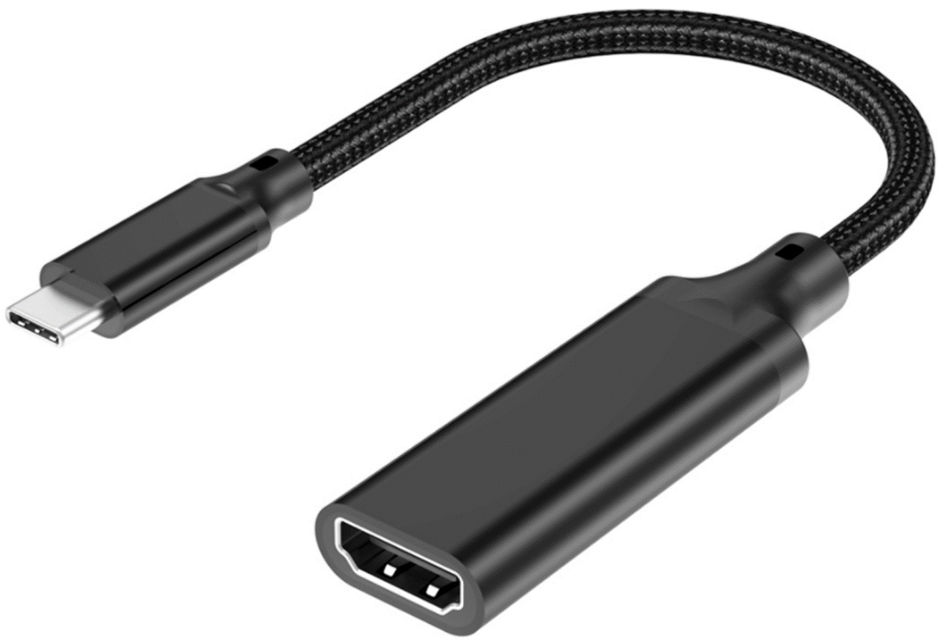
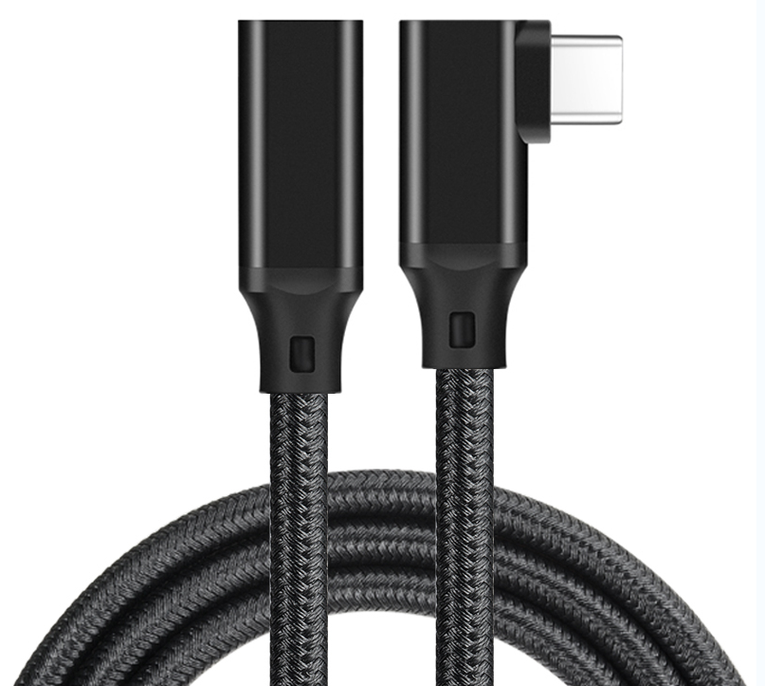
USB Cable
Model:PJ11
Model:PJ12
Model:PJ13
Model:PJ14
Model:PJ15
Model:PJ16
Model:PJ17
Model:PJ18
Model:PJ19
Model:PJ20
https://pj-cable.com

Slide 10
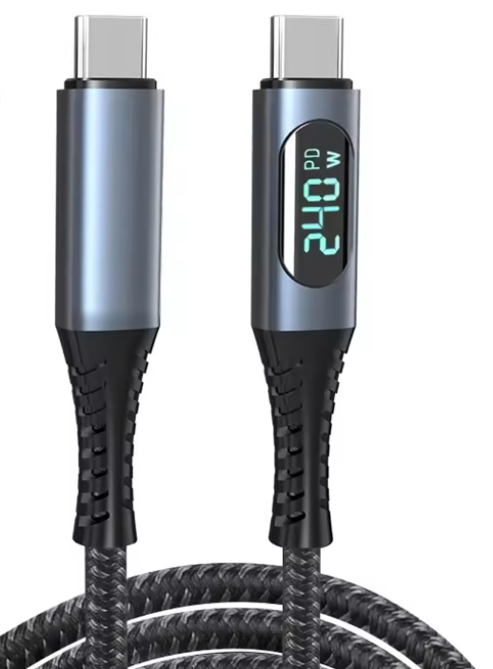
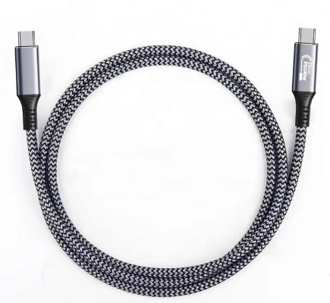
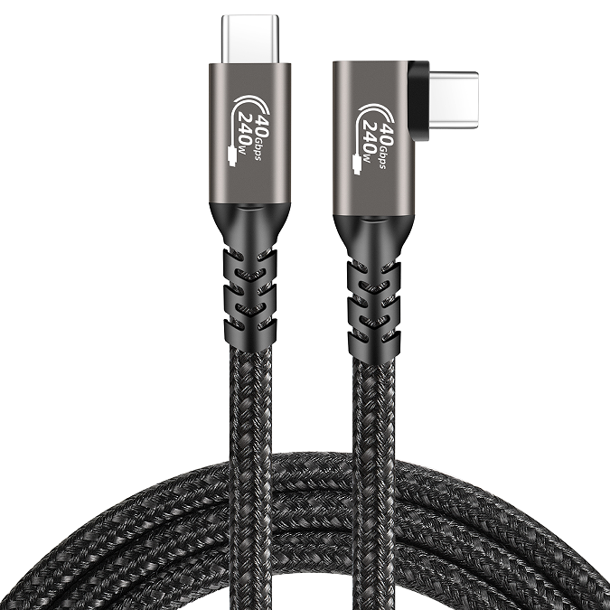
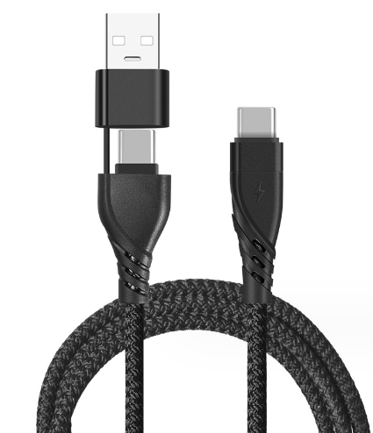
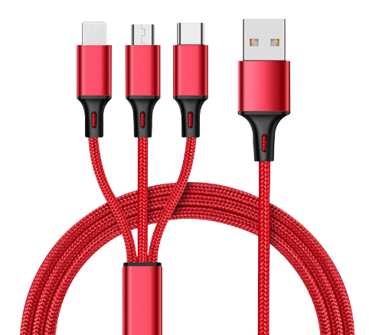
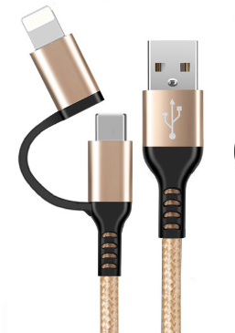




USB Cable
Model:PJ21
Model:PJ22
Model:PJ23
Model:PJ24
Model:PJ25
Model:PJ26
Model:PJ27
Model:PJ28
Model:PJ29
Model:PJ30
https://pj-cable.com

Slide 11










USB Cable
Model:PJ31
Model:PJ32
Model:PJ33
Model:PJ34
Model:PJ35
Model:PJ36
Model:PJ37
Model:PJ38
Model:PJ39
Model:PJ40
https://pj-cable.com

Slide 12










USB Cable
Model:PJ41
Model:PJ42
Model:PJ43
Model:PJ44
Model:PJ45
Model:PJ46
Model:PJ47
Model:PJ48
Model:PJ49
Model:PJ50
https://pj-cable.com

Slide 13










USB Cable
Model:PJ51
Model:PJ52
Model:PJ53
Model:PJ54
Model:PJ55
Model:PJ56
Model:PJ57
Model:PJ58
Model:PJ59
Model:PJ60
https://pj-cable.com

Slide 14










USB Cable
Model:PJ61
Model:PJ62
Model:PJ63
Model:PJ64
Model:PJ65
Model:PJ66
Model:PJ67
Model:PJ68
Model:PJ69
Model:PJ70
https://pj-cable.com

Slide 15










USB Cable
Model:PJ71
Model:PJ72
Model:PJ73
Model:PJ74
Model:PJ75
Model:PJ76
Model:PJ77
Model:PJ78
Model:PJ79
Model:PJ80
https://pj-cable.com

Slide 16









USB Cable
Model:PJ81
Model:PJ82
Model:PJ83
Model:PJ84
Model:PJ85
Model:PJ86
Model:PJ87
Model:PJ88
Model:PJ89
https://pj-cable.com

Slide 17










Audio Cable
Model:PJ90
Model:PJ91
Model:PJ92
Model:PJ93
Model:PJ94
Model:PJ95
Model:PJ96
Model:PJ97
Model:PJ98
Model:PJ99
https://pj-cable.com

Slide 18










Audio Cable
Model:PJ100
Model:PJ101
Model:PJ102
Model:PJ103
Model:PJ104
Model:PJ105
Model:PJ106
Model:PJ107
Model:PJ108
Model:PJ109
https://pj-cable.com

Slide 19


Print Cable
Model:PJ110
Model:PJ111
https://pj-cable.com

Slide 20
Contact Information
Please Feel Free to Inquiry US
E-mail: info@pj-data.com
https://pjcable.com

